Slide 1




Employee Attrition Analysis
Instructor: Prof. Khasha Dehnad
Course: CS 513 Knowledge Discovery and Data Mining
Meghana Bhat Manikal Akhil Manchikanti Rajat Verma Sanam Sritam Jena
Course Section: A Course Section: A Course Section: A Course Section: B
Department: CS Department: CS Department: CS Department: CS
Level: Graduate Level: Graduate Level: Graduate Level: Graduate

Slide 2
Introduction
Staff attrition refers to the loss of employees through a natural process, such as retirement, resignation, elimination of a position, personal health, or other similar reasons. With attrition, an employer will not fill the vacancy left by the former employee
Attrition is often viewed as a way that companies can decrease labor costs. Take for instance more severe forms of attrition—like layoffs—which are often deployed as a labor reduction technique. If an employee leaves naturally, and their spot no longer needs to be filled, organizations can freeze hiring to reduce staffing costs.
Every year a lot of companies hire several employees. The companies invest time and money in training those employees, not just this but there are training programs within the companies for their existing employees as well. These programs aim to increase the effectiveness of their employees.

Slide 3
Agenda
Brief Summary & Goals
Dataset Description
Data selection, cleaning and observation
Conclusions

Slide 4
Brief Summary & Goals
Summary:-
The project was intended to detect potential attrition from a slightly imbalanced dataset. Performed data analysis and developed machine learning models in order to detect potential attritions.
Goals:-
To show the companies are able to identify potential employees who are going to be leaving the company in the near future so that they do not have to deal with attrition cost by making replacements available prior to them leaving the organization or offering the employee some additional compensation in order to retain them.

Slide 5
Dataset Description
Attrition data has been taken from some organization who wish to obtain meaningful insight on employee retention.
There are a total of 27 features like Job satisfaction, Sex, Job Group, Annual rate, hourly rate, termination year etc.
Data set has 3 columns which has unspecified data (NA) that needs to be considered
Target variable is Status which has two different class Terminated or Active
There is a total of 9166 samples
We don’t find any noisy data i.e. where there is no employee id or no JOB_GROUP
Annual rate includes some extra credits like overtime pay and bonuses and thus can not be directly deduced from hourly rate
Referral source NA and unknown are not same
Features:- ANNUAL_RATE, HRLY_RATE, JOBCODE, ETHNICITY, SEX MARITAL_STATUS, JOB_SATISFACTION, AGE, etc.

Slide 6
Dataset selection, cleaning and observation
The dataset has been divided into training and test set with 70:30 ratio.
We found that the data set has majority of the missing fields for the column “TERMINATION_YEAR” so we re organized the data with the employees who have been terminated as TRUE and the employees who have not been terminated as FALSE in the column “TERMINATION_YEAR”
Since the ranges were different, we normalized the data for our analysis.
The methodologies used are:-
A. Correlations
B. Artificial Neural Network (ANN)
C. Kohonen
D. Naïve Bayes
E. Random Forest
F. CART
G. Decision Tree
H. K-Means
I. Support Vector Machine (SVM)
J. H-Clust
K. K-nearest neighbor (KNN)

Slide 7
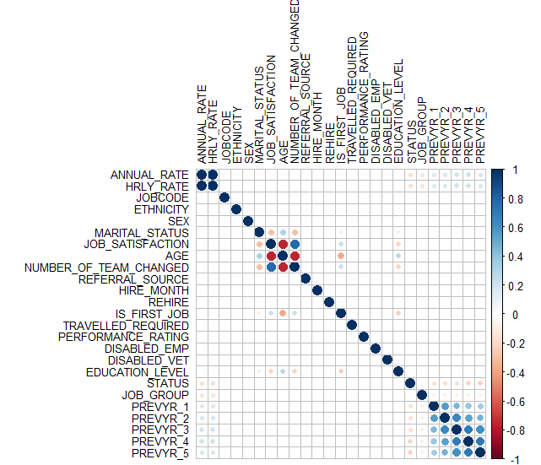
Correlations

Slide 8
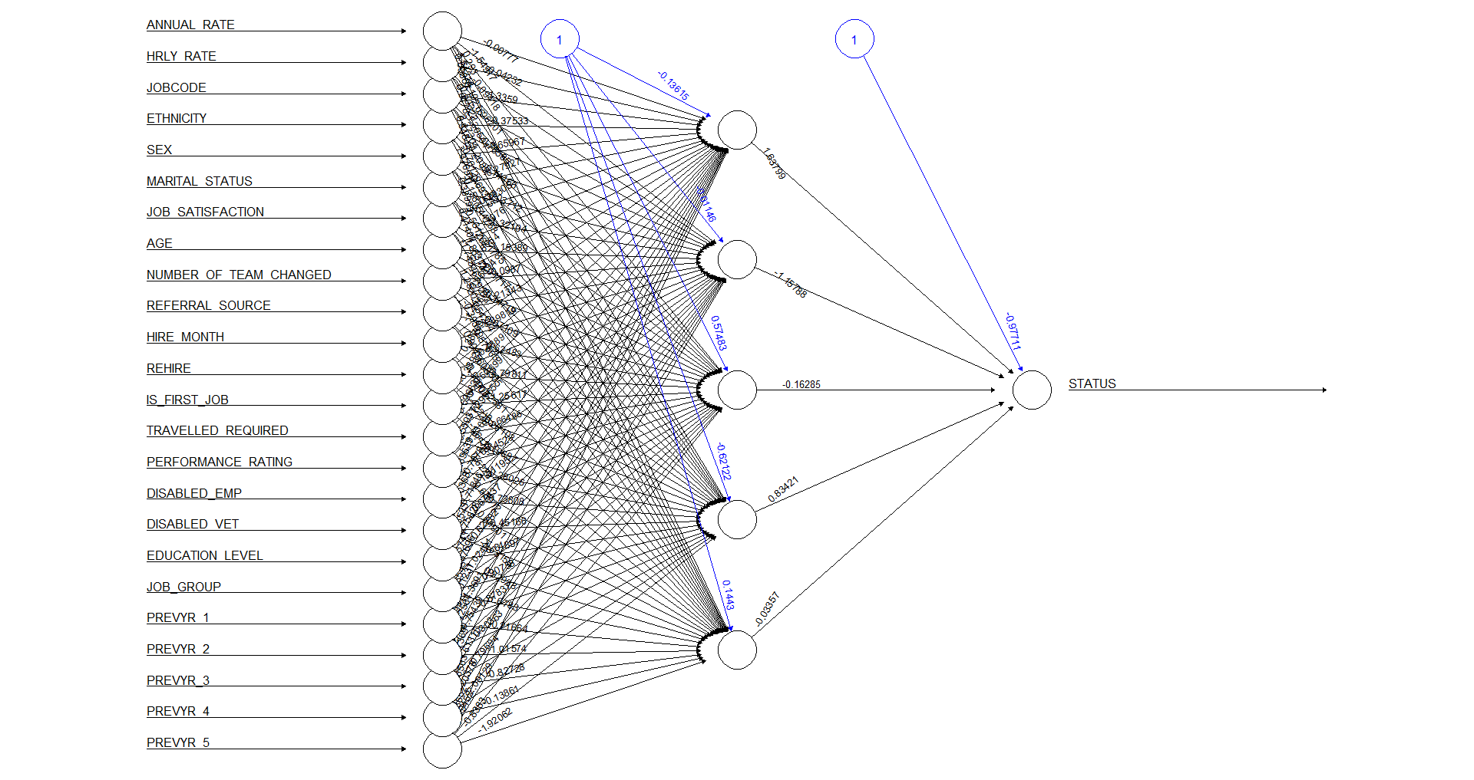
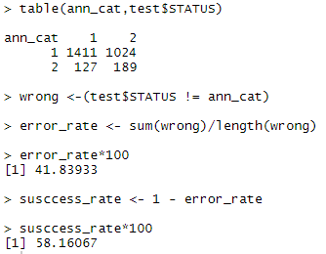
Artificial Neural Network (ANN)

Slide 9
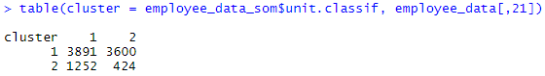
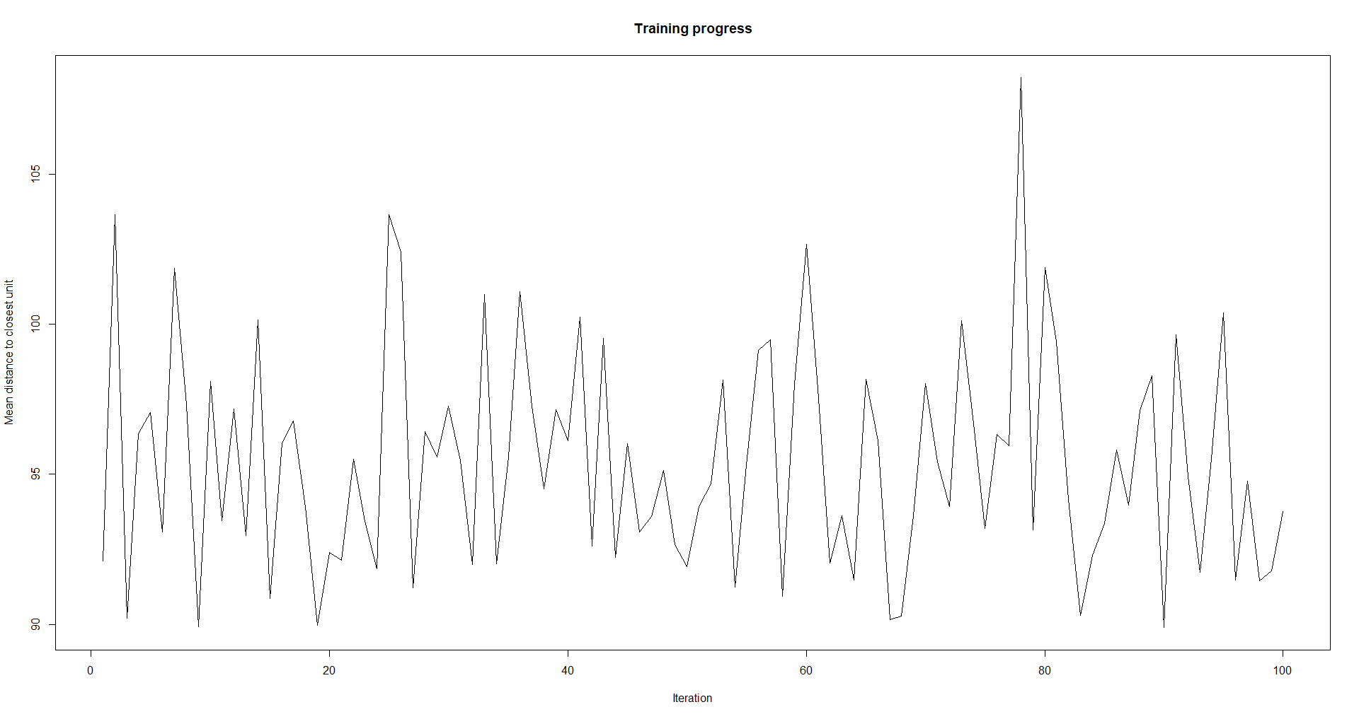
Kohonen

Slide 10
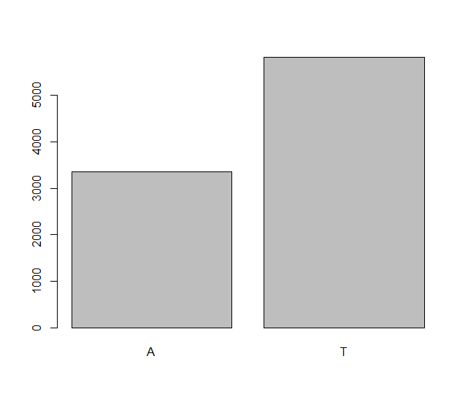
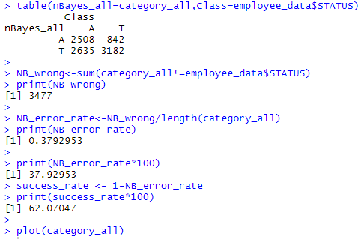
Naïve Bayes

Slide 11
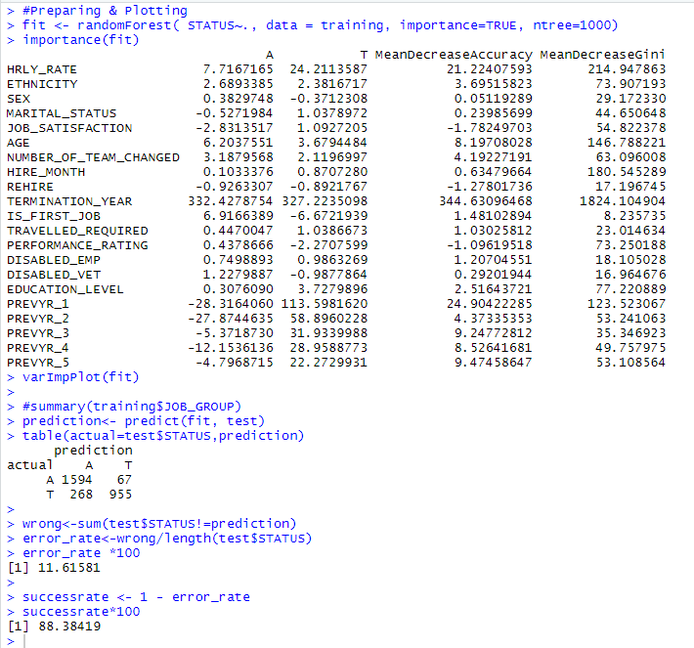
Random Forest

Slide 12
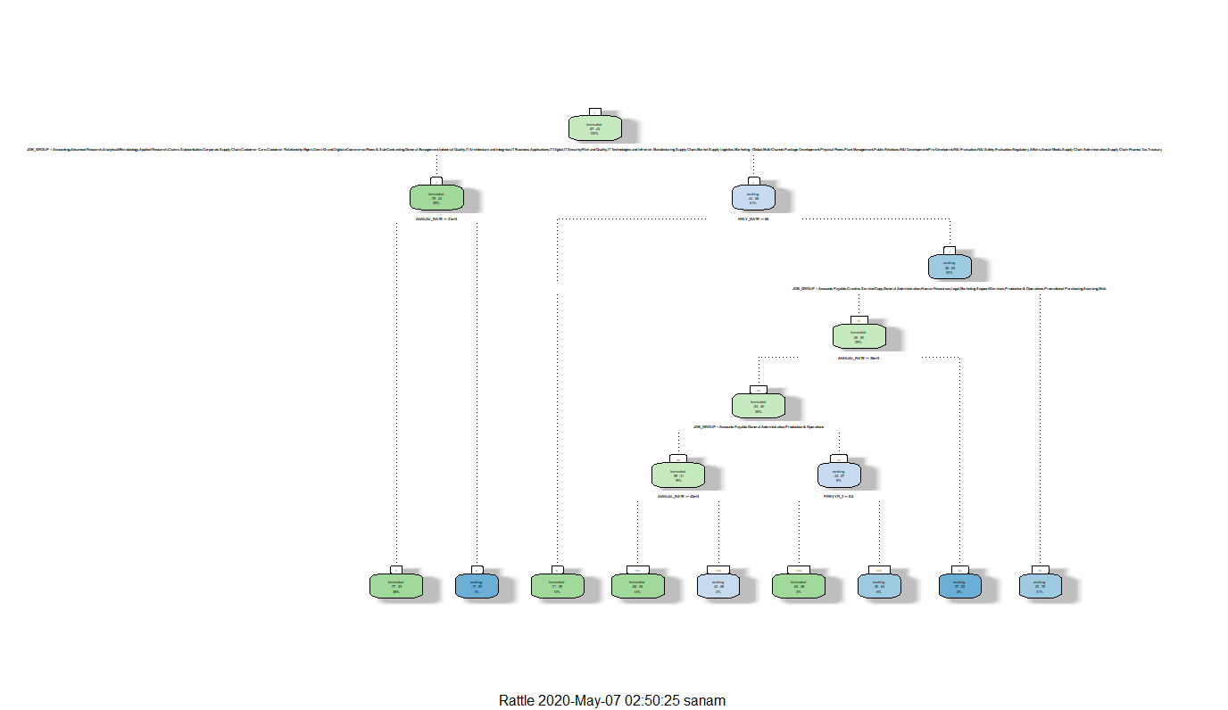
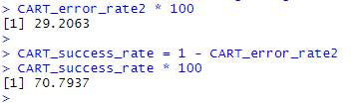
CART

Slide 13
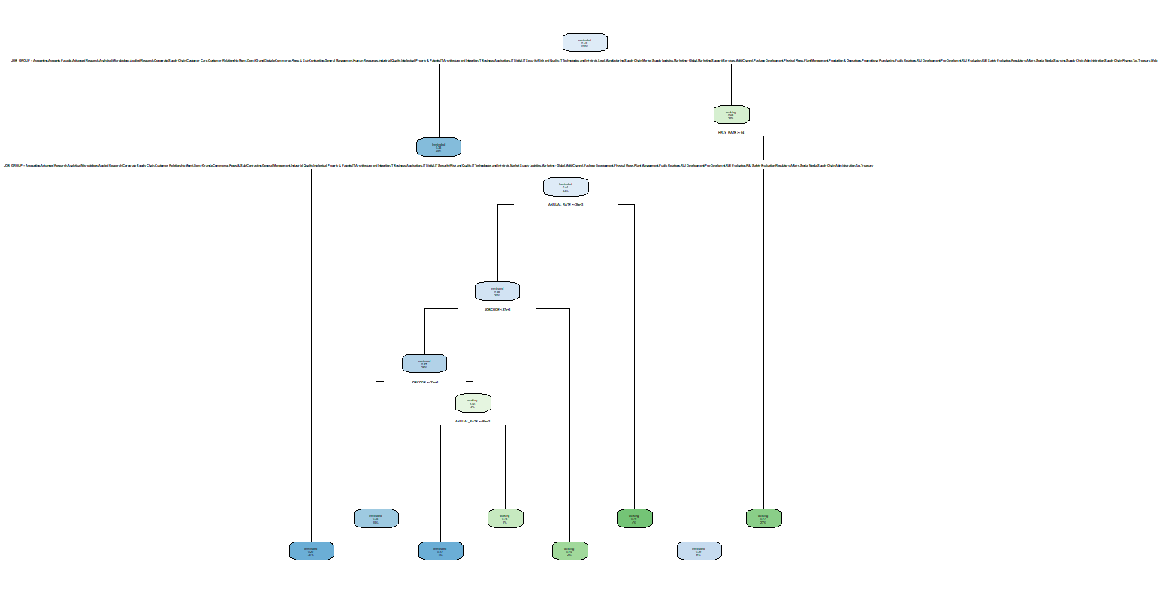
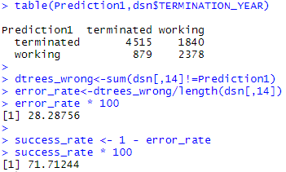
Decision Tree

Slide 14
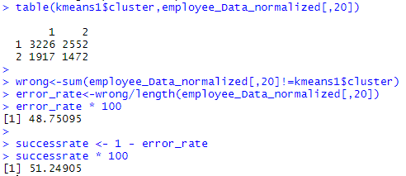
K-Means

Slide 15
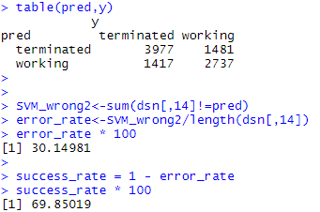
Support Vector Machine (SVM)

Slide 16
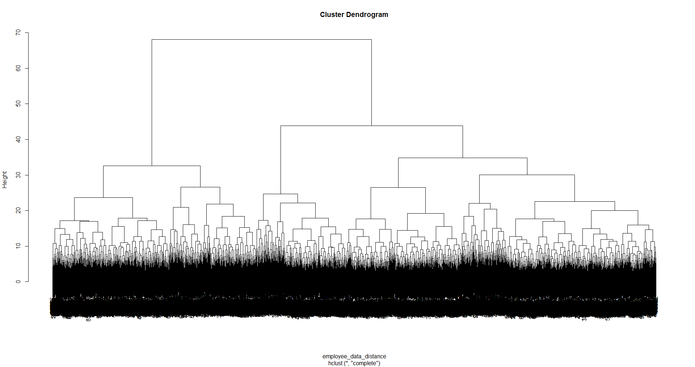
H-Clust

Slide 17
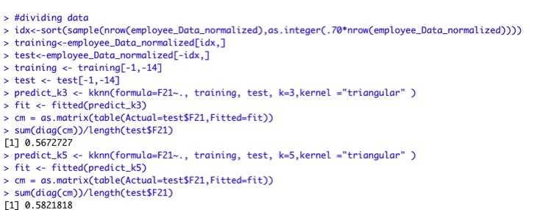
K-nearest neighbor (KNN)

Slide 18
Conclusions
By using the above methodology, we have the following observations:-
Correlations | Found the relationship between different variables
Artificial Neural Network (ANN) | Predictions was almost close but since there was minor differences with the values after decimal, error rates got increased. Success rate 58.16
Kohonen | Since table is spread across multiple columns we used kohonen to bring down the columns to understand better.
Naïve Bayes | 62.07
Random Forest | Found out the mean decrease of different variables with a success rate of 88.38
CART | 70.79
Decision Tree | 71.71
K-means | 51.24
Support Vector Machines | 69.85
H-Clust | Dendrogram was drawn
K-nearest neighbour (KNN) | With K=3, 56.72% Accuracy & with K=5, 58.21% Accuracy was achieved.

Slide 19
Thank You

